Slide 1
Tutorial #1: HTML and CSS
Aashik Azim

Slide 2
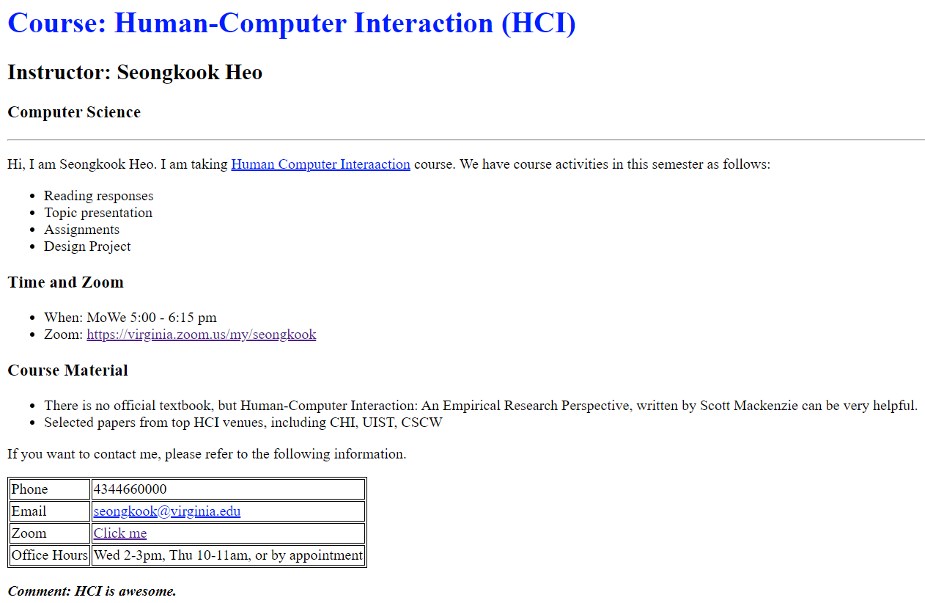
Learning Objective
Student will be able to build their own website with HTML and will be able to furnish it using CSS style.
Goal: Construct following website – hands-on

Slide 3
HTML and Web Browser
HyperText Markup Language – a language for building web pages.
Web browser – A software that interpret and render web pages
Different browser may present different result
We will use the latest version of Chrome browser
Version 84.0.4147.105 (64-bit)

Slide 4
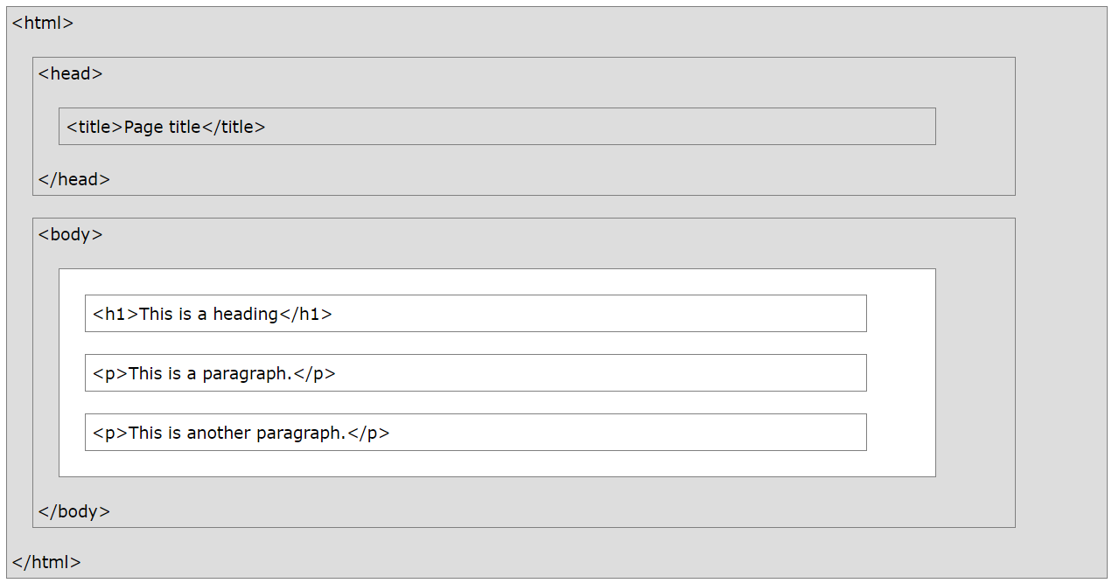
HTML page structure

Slide 5
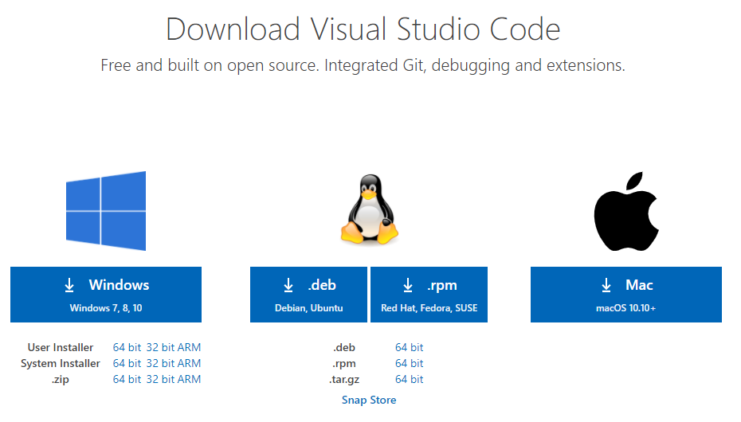
Short Demo – “Hello World” on Chrome
Let’s use visual studio code
It is free for windows, Mac, and Linux
Easy to code, and debug

Slide 6
Short Demo – “Hello World” on Chrome – Contd.
Create a workspace from visual studio code
First, open a folder
File → Open Folder → create a new folder/use an existing one
Second, select the folder from panel (left)
Third, save the folder as a workspace
File → save as workspace → give a workspace name, e.g., “sample-ws” → hit enter
Or, follow the instruction from this video: https://www.youtube.com/watch?v=iIibgEg2Bw0

Slide 7

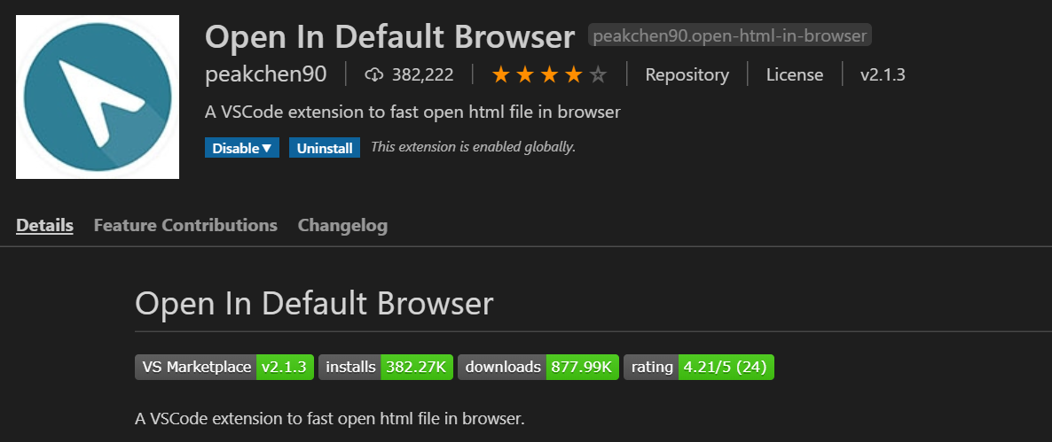
Integrate browser for html render
Click on the settings icon (left lower corner) →
Select Extensions
Search for “Open in Default Browser” extension
Select the extension and install it
This is required only for the first time

Slide 8
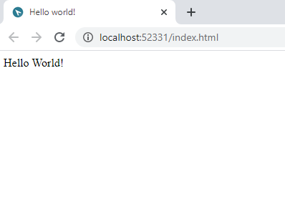
Run index.html file.
Now right click on the index.html file and then select “Open in default browser”
See the output in browser as follows:
Then you are done with first html program

Slide 9
Now, let’s code for the following website

Slide 10
How do we make “fancy” website?
Font

Slide 11
How do we make “fancy” website?
Font
Horizontal line

Slide 12
How do we make “fancy” website?
Font
Horizontal line
Hyper link

Slide 13
How do we make “fancy” website?
Font
Horizontal line
Hyper link
Listing, different font, margin

Slide 14
How do we make “fancy” website?
Font
Horizontal line
Hyper link
Listing, different font, margin
Table

Slide 15
Demo
Write the code after me on visual code

Slide 16
Summary of HTML
A language for creating web pages
Different browser may present different result
Terms:
Elements: <tag> contents </tag>
Tags: <h1>, <ul>, <table>, …
Attributes: href=https://google.com”
YOU DON’T NEED TO MEMORIZE TAGS
Google it whenever you want to do something
Tag list: https://www.w3schools.com/TAGS/default.ASP

Slide 17
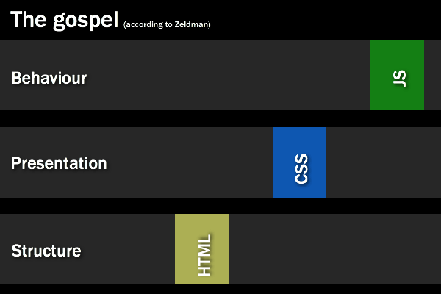
Summary of HTML

Slide 18
Summary of HTML
Tutorial #2
Tutorial #1

Slide 19
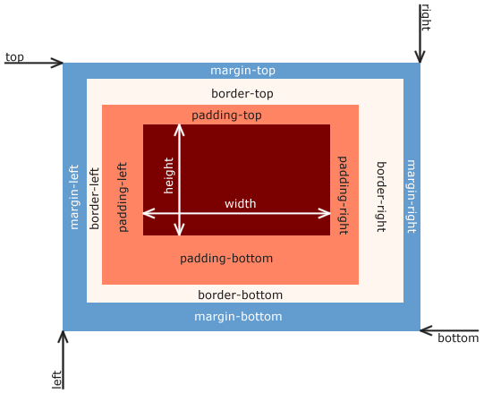
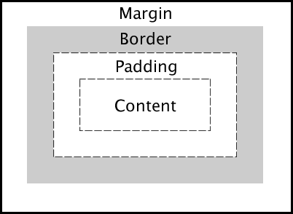
Cascading Style Sheets
A language for presenting contents
CSS Box model
An element can be considered as a box

Slide 20
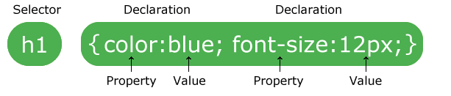
CSS Syntax
A CSS rule-set consists of a selector and a declaration block:
Image source: w3school

Slide 21
CSS Selector
CSS selectors are used to "find" (or select) the HTML elements you want to style.
CSS element selector
CSS id selector
CSS class selector
Combination of selectors
…

Slide 22




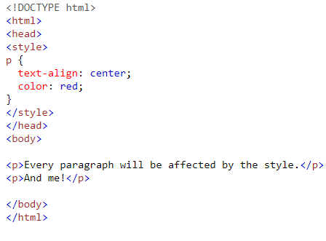
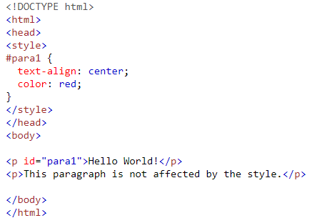
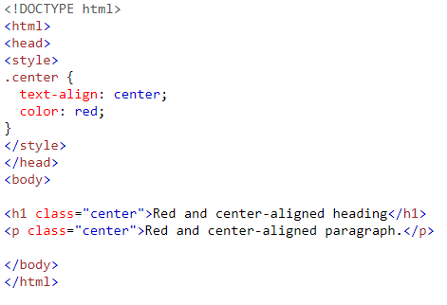
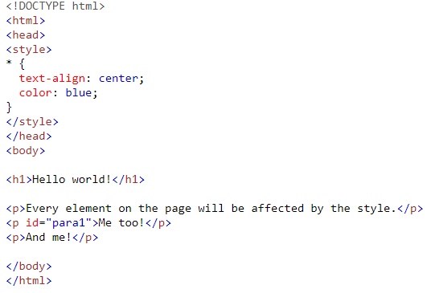


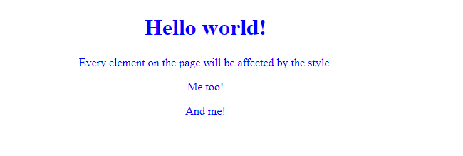

CSS Selector Examples
Element selector
Id selector
Class selector
Universal selector
Sample
HTML
Output
Image source: w3school

Slide 23
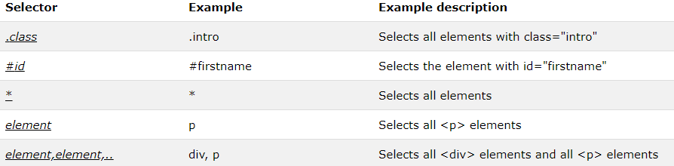
CSS Selector Summary
Image source: w3school

Slide 24
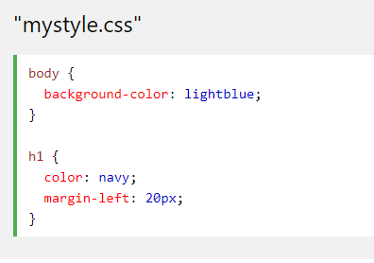
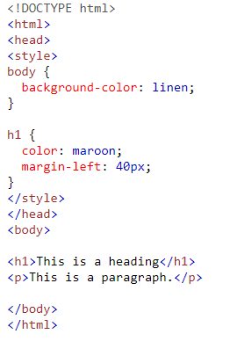
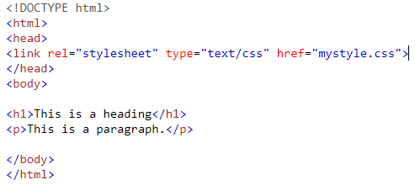
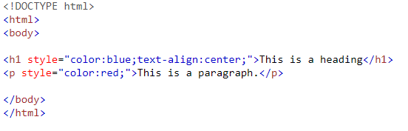
How to Add CSS?
There are three ways to insert CSS:
External CSS
Internal CSS
Inline CSS
External
Internal
Inline

Slide 25
Demo
Write the code after me on visual studio code

Slide 26
Summary of CSS
A language for presenting contents
Separation of presentation and content
You can apply same format to:
All elements with a tag
A group of elements → (class)
An element → (id)
YOU DON’T NEED TO MEMORIZE STYLYING
Google it whenever you want to do something
More on: https://www.w3schools.com/css/css_intro.asp

Slide 27
Next day: Tutorial#2 Javascript
How do we make the web page do something?
Increase the size of the font when I click a button
Send an email with contents that user typed
Javascript could be a solution

Slide 28
Thank You!
Questions?

